Slide 1
What is a language?
Alphabet – finite character set (Σ)
String – finite sequence of characters – can be ε, the empty string (Some texts use λ as the empty string)
Language – possibly infinite set of strings over some alphabet – can be { }, the empty language.
CS 540 Spring 2013 GMU

Slide 2
Suppose Σ = {a,b,c}. Some languages over Σ could be:
{aa,ab,ac,bb,bc,cc}
{ab,abc,abcc,abccc,. . .}
{ ε }
{ }
{a,b,c,ε}
…
CS 540 Spring 2013 GMU

Slide 3
Why do we care about Regular Languages?
Formally describe tokens in the language
  Regular Expressions
  NFA
  DFA
Regular Expressions ➔ finite automata
Tools assist in the process
CS 540 Spring 2013 GMU

Slide 4
Regular Expressions
The regular expressions over finite Σ are the strings over the alphabet Σ + { ), (, |, * } such that:
{ } (empty set) is a regular expression for the empty set
ε is a regular expression denoting { ε }
a is a regular expression denoting set { a } for any a in Σ
CS 540 Spring 2013 GMU

Slide 5
Regular Expressions
4. If P and Q are regular expressions over Σ, then so are:
  P | Q (union)
    If P denotes the set {a,…,e}, Q denotes the set {0,…,9} then P | Q denotes the set {a,…,e,0,…,9}
  PQ (concatenation)
    If P denotes the set {a,…,e}, Q denotes the set {0,…,9} then PQ denotes the set {a0,…,e0,a1,…,e9}
  Q* (closure)
    If Q denotes the set {0,…,9} then Q* denotes the set {ε,0,…,9,00,…99,…}
CS 540 Spring 2013 GMU

Slide 6
Examples
If Σ = {a,b}
(a | b)(a | b)
(a | b)*b
a*b*a*
a*a (also known as a+)
(ab*)|(a*b)
CS 540 Spring 2013 GMU

Slide 7
Σ = {a, b}
This means the language uses only the symbols a and b.
CS 540 Spring 2013 GMU

Slide 8
(a | b)(a | b)
  This means: a or b, followed by a or b.
  Matches: aa, ab, ba, bb
  This describes all strings of length 2 over {a, b}.
CS 540 Spring 2013 GMU

Slide 9
2. (a | b)*b
This means: any string of a’s and b’s ending in a b.
(a | b)* matches any string (including empty),
and b enforces that it must end with a b.
Matches: b, ab, aab, bab, abba, etc.
Does not match: a, aa, aba
CS 540 Spring 2013 GMU

Slide 10
a*b*a*
  Zero or more a’s, followed by zero or more b’s, followed
  by zero or more a’s.
  Matches: b, aaabaaa, aabbaaa, aab, bbaaa, aa, etc.
  This allows a's on both sides of the b block.
CS 540 Spring 2013 GMU

Slide 11
a*a (also known as a⁺)
  One or more a’s.
  a* = zero or more a’s; adding a final a ensures
  at least one occurs.
  This is the same as the shorthand a⁺ = one or more a’s.
  Matches: a, aa, aaa, etc.
  Does not match: empty string
CS 540 Spring 2013 GMU

Slide 12
(ab*)|(a*b)
  This is an OR of two expressions:
    ab*: an a followed by zero or
    more b’s → a, ab, abb, abbb, etc.
    a*b: zero or more a’s, followed
    by b → b, ab, aab, etc.
  Matches both kinds: ab, a, abb, b, aab, etc.
  Union includes both patterns.
CS 540 Spring 2013 GMU

Slide 13
Nondeterministic Finite Automata
A nondeterministic finite automaton (NFA) is a mathematical model that consists of
A set of states S
A set of input symbols Σ
May have multiple transition function that maps state/symbol pairs to a set of states:
    S x {Σ + ε} → set of S
A special state s₀ called the start state
Have epsilon ε-transitions or lambda transitions
A set of states F (a subset of S) of final states
INPUT: string
OUTPUT: yes or no
CS 540 Spring 2013 GMU

Slide 14
Example NFA
Transition Table:
a
0
1
2
3
STATE | a | b | ε
0 | 0,3 | 0 | 1
1 |  | 2
2 |  | 3
3
ε
b
b
a,b
S = {0,1,2,3}
S₀ = 0
Σ = {a,b}
F = {3}
CS 540 Spring 2013 GMU

Slide 15
Key Definitions:
States (S): {0, 1, 2, 3}
Start state (S₀): 0
Alphabet (Σ): {a, b}
Final/Accepting state (F): {3}
CS 540 Spring 2013 GMU

Slide 16
State 0:
  On 'a', go to state 0 (loop) and state 3 (non-deterministic jump).
  On 'b', go to state 0 (loop).
  On ε (epsilon), go to state 1 (without consuming input).
State 1:
  On 'b', go to state 2.
State 2:
  On 'b', go to state 3.
State 3:
  Is a final state. No transitions from here.
CS 540 Spring 2013 GMU

Slide 17
Graph Explanation
The yellow state 0 is the start state.
It loops on a and b.
It can transition via ε to state 1, starting a path through b → b to reach the accepting state 3 (turquoise).
State 0 also non-deterministically transitions directly to state 3 on input a, giving alternate acceptance paths.
CS 540 Spring 2013 GMU

Slide 18
What Strings Are Accepted?
Let’s trace a few:
"a"
  From 0, on "a", go to 3 → Accepted
"bb"
  From 0, ε to 1 → b → 2 → b → 3 → Accepted
"ab"
  From 0, on "a" → go to 0 and 3
  From 3: finished (1 character) → Accepted
  From 0 → on "b", stay in 0 → not accepted yet
  But because 3 is accepting → Accepted
"aaa"
  From 0 → loops on "a" each time, stays in 0
  Never reaches 3 via ε unless a switch is made
  But on any "a", it could nondeterministically jump to 3 → Accepted
CS 540 Spring 2013 GMU

Slide 19
This NFA is nondeterministic, allowing multiple paths.
It accepts strings like "a", "bb", "ab", "bba", etc.
ε-transitions allow jumping to another computation path without consuming a character.
The final state is 3, and any path that leads to it accepts the string.
CS 540 Spring 2013 GMU

Slide 20
Deterministic Finite Automata
A deterministic finite automaton (DFA) is a mathematical model that consists of
A set of states S
A set of input symbols Σ
A Unique transition function that maps state/symbol pairs to a state:
    S x Σ → S
A special state s₀ called the start state
A set of states F (a subset of S) of final states
INPUT: string
OUTPUT: yes or no
CS 540 Spring 2013 GMU

Slide 21
Deterministic Finite Automata (DFAs)
Formal Definition, Structure, Example, and Transition Representation

Slide 22
Definition
A Deterministic Finite Automaton (DFA) is a finite automaton with:
• No ε (epsilon) transitions
• Exactly one transition per state-symbol pair
It functions as a finite state machine that precisely recognizes a regular expression (RE).

Slide 23
2. Components of a DFA
Formally, a DFA is a 5-tuple:
D = (Q, Σ, δ, q₀, F)
Where:
Q: Finite set of states
Σ: Input alphabet
δ: Transition function Q × Σ → Q
q₀: Start state
F: Set of accepting (final) states

Slide 24
How a DFA Works
A DFA accepts a string if:
• Starting at q₀, it reads the string symbol by symbol
• For each input, it follows a defined transition
• If the final state reached is in F, the string is accepted
• Otherwise, it is rejected

Slide 25
Transition Table Representation
A DFA can also be expressed using a transition table T:
T[s, c] gives the next state when in state s with input c
This format helps in systematically defining all transitions

Slide 26
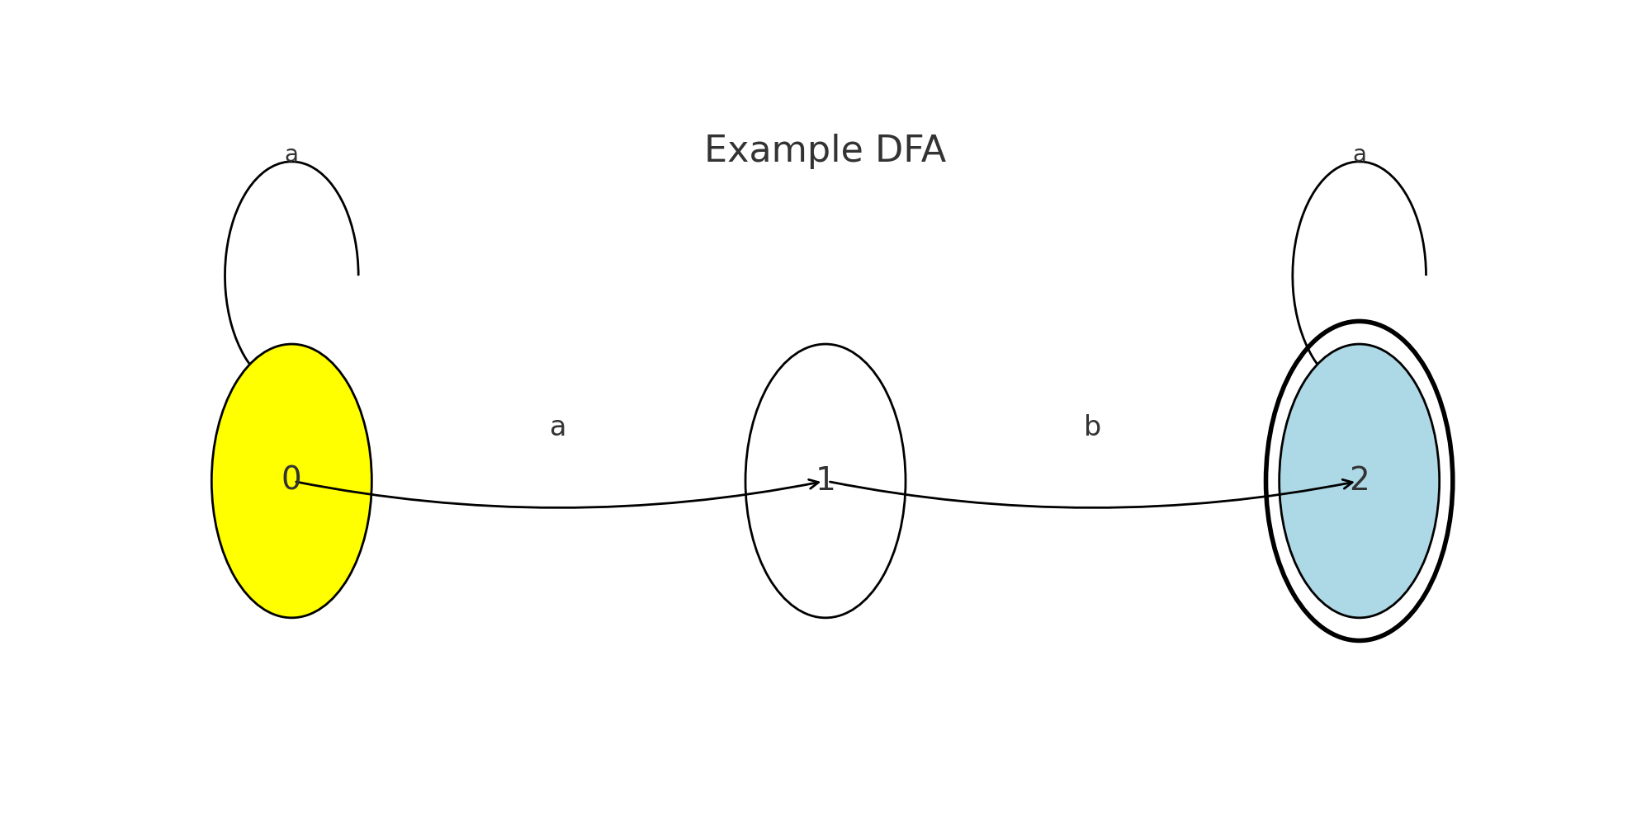
DFA Diagram

Slide 27
DFA Recognizing Strings with 'ab'
Includes optional leading and trailing 'a's

Slide 28
DFA Structure Explanation
States:
q0: Start state
q1: After reading 'a'
q2: Final state after 'ab'
Transitions:
q0 → q1 on 'a'
q1 → q2 on 'b'
q2 → q2 on 'a'
q0 → q0 on 'a'
q2 is the accepting state (double circle)

Slide 29
How This DFA Works
Starts at q0
Requires at least one occurrence of 'ab' to reach q2
Once in q2, it stays there on any number of 'a's
Extra 'a's before 'ab' are handled by looping at q0

Slide 30
Accepted and Rejected Strings
Accepted Strings:
ab
aab
aaba
aaabaaa
Rejected Strings:
a
aa
aaa
b

Slide 31
DFA Explanation: Recognizing (abc)+c*
Deterministic Finite Automaton (DFA) Analysis

Slide 32
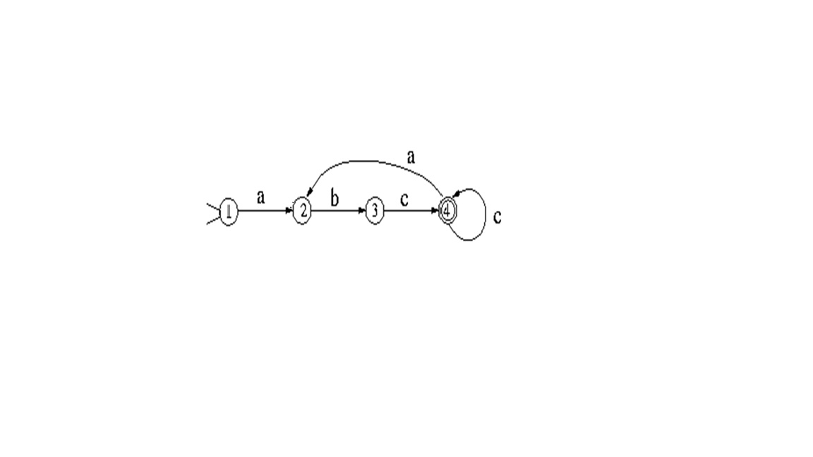
DFA Diagram
The DFA below accepts strings of the form (abc)+ followed by optional c's.

Slide 33
DFA Transitions
Transitions:
- q1 --a--> q2
- q2 --b--> q3
- q3 --c--> q4 (accepting)
- q4 --c--> q4 (loop)
- q4 --a--> q2 (restart abc cycle)

Slide 34
Accepted Strings
Examples of Accepted Strings:
✔ abc
✔ abcc
✔ abcabc
✔ abcabcabc
✔ abcabccccc

Slide 35
Rejected Strings
Examples of Rejected Strings:
✘ a
✘ ab
✘ ac
✘ abcab
✘ abcabca

Slide 36
Language Description and Regular Expression
The DFA accepts strings that:
- Start with one or more occurrences of 'abc'
- May be followed by any number of 'c's
Regular Expression:
(abc)+c*

